Slide 1
Welcome Orientation
Friday, December 14, 2012
2:00pm – 3:00pm EST
Dial Info: 1-877-668-4490
Access Code 661 628 800

Slide 2
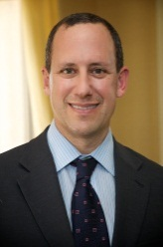
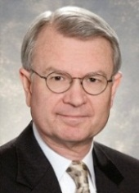
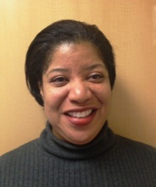
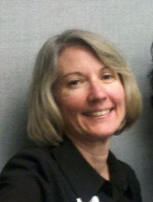
Introducing the
Measure Up Pressure Down Team
Jerry Penso, MD, MBA
Chief Medical and Quality Officer
jpenso@amga.org
703-838-0033 x356
Judy Lubin, MPH
Project Director
jlubin@amga.org
703-838-0033 x346
Sherry Greenwood
Development Coordinator
sgreenwood@amga.org
703-838-0033 x352
John Cuddeback, MD, PhD
Chief Medical Informatics Officer
jcuddeback@amga.org
703-838-0033 x359
Joyce Jones
Quality Program Coordinator
jjones@amga.org
703-838-0033 x340
1

Slide 3
Today’s Agenda
Campaign overview – Jerry Penso
Project updates – Judy Lubin
AMGF and supporting organizations – Sherry Greenwood
Outcomes measurement – John Cuddeback
Next Steps and upcoming events – Joyce Jones
2

Slide 4
Campaign Overview
3

Slide 5
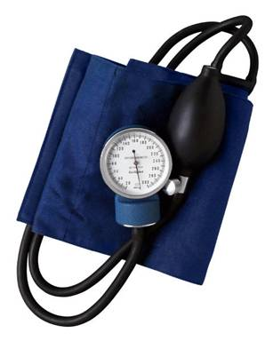
Goals of Three-Year Campaign
Measurable improvements in high blood pressure prevention, detection, and control
80% of patients at goal according to JNC7
75% of AMGA membership adopt (at least one) campaign planks.
Engage and empower patients to actively manage their health.
4

Slide 6
Medical Groups: What You Do
Adopt one or more care processes that lead to measureable improvements in blood pressure control
5
Notes:
Ok I would recommend the previous slide to tell what AMGF gives you and then this slide to show what you have to do and then reiterate the benefits at some point. Photo is not good quality unfortunately. Do you have any other real photos or can you take some?
Too busy, too much text
Photos mis-shapen
Break it up
Medical groups will be challenged to adopt one or more evidence-based care processes that lead to
measureable improvements in blood pressure control. To support medical groups in this effort, AMGF will offer a provider toolkit with best practice tips, examples and expert videos; host webinars and other
educational and collaborative opportunities; provide tools to promote involvement with the campaign; access to Anceta (benchmarking and evaluation data); and opportunities for national recognition.

Slide 7
80% of Patients at Goal Blood Pressure
Processes to Achieve Goal
Direct Care Staff trained in accurate BP measurement
Hypertension Guideline used and adherence monitored
BP addressed for every hypertension patient, every primary care visit
All patients not at goal and with new Rx seen within 30 days
Prevention, engagement, and self-management program in place
Registry used to identify and track hypertension patients
All team members trained in importance of BP goals
All specialties intervene with patients not in control
6
Notes:
This could work if you bring it in a piece at a time see this in Slide Show mode
Colors should keep with primary tones used
Un capitalize as I did in green boxes and bold
Bring in each section at a time. Maybe break over slides take out Planks titles. You can sy them.
Bigger

Slide 8
Your Assessment Survey Results
7

Slide 9
Have you created a quality team for hypertension?

Slide 10
Have you already adopted any of the planks of the AMGF campaign?

Slide 11
Which planks have you adopted?

Slide 12
Has your organization formally adopted performance goals for hypertension?

Slide 13
Do you have a system-wide EHR?

Slide 14
Do you have a group-level hypertension measurement? (e.g., percent of patients in control)?

Slide 15
Do you report hypertension results to any external organization?

Slide 16
Do you have a searchable clinical repository or data warehouse that includes blood pressure readings?

Slide 17
Project Updates
16

Slide 18
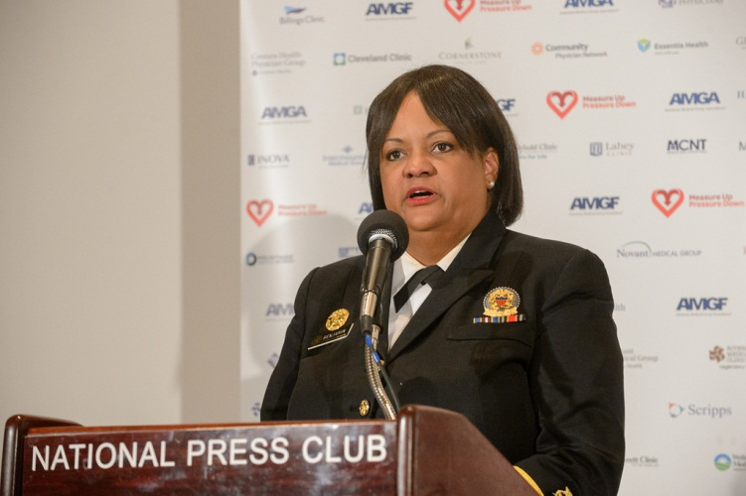
Official Launch of Measure Up Pressure Down
17

Slide 19
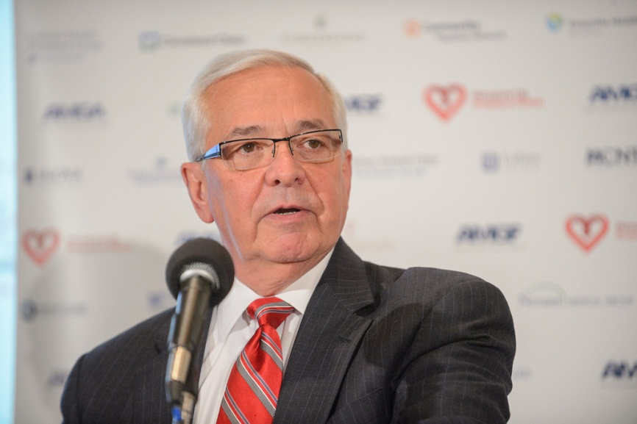
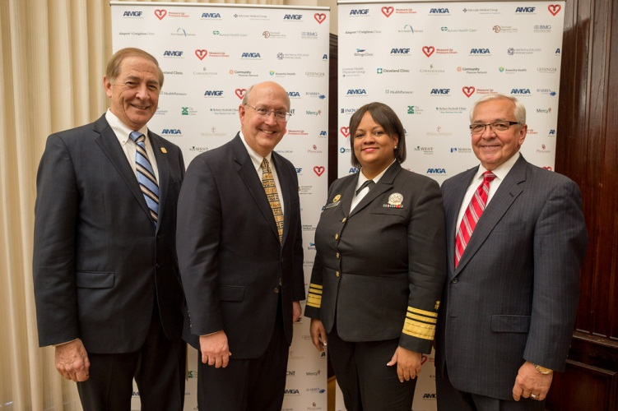
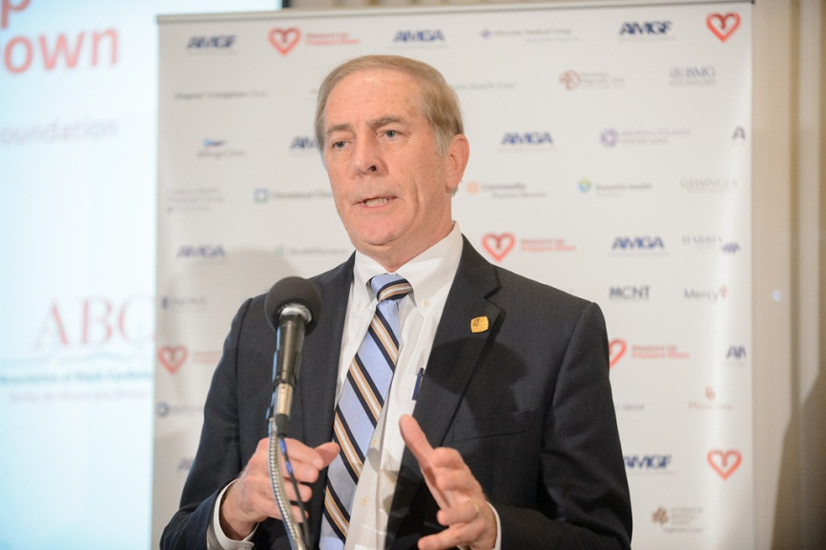
November 29, 2012 National Press Club Washington DC
18

Slide 20
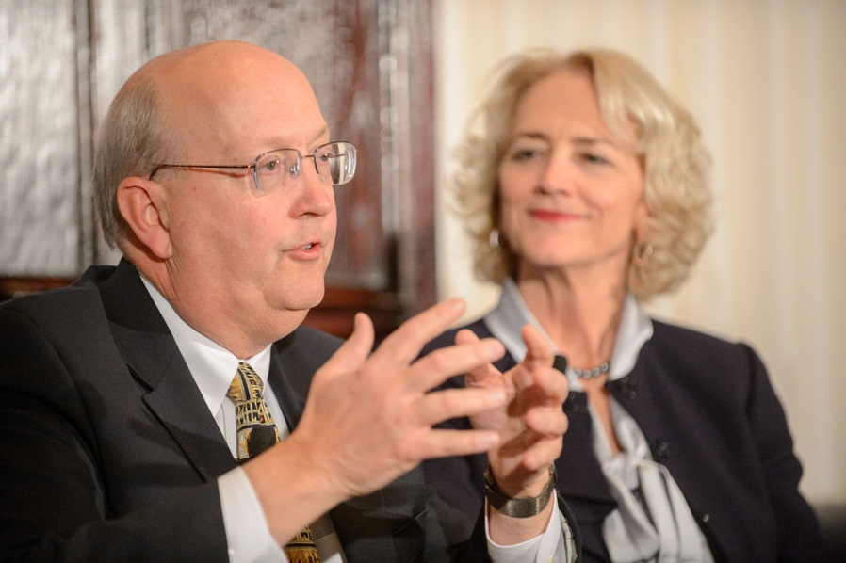
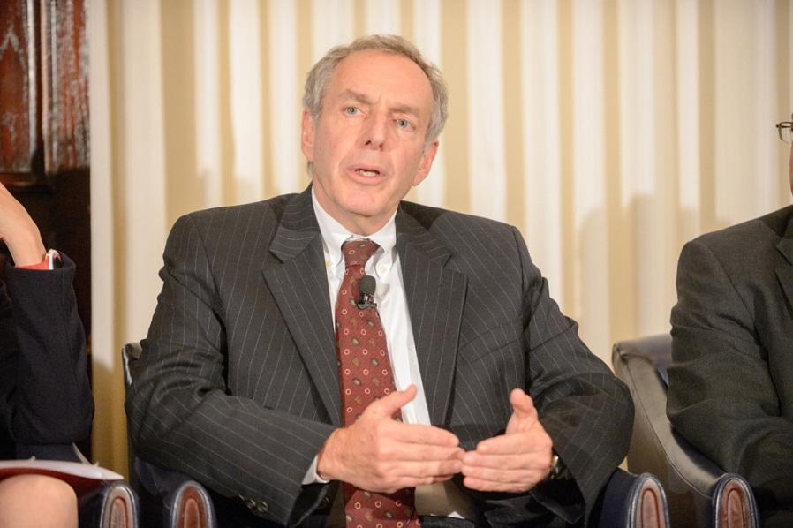
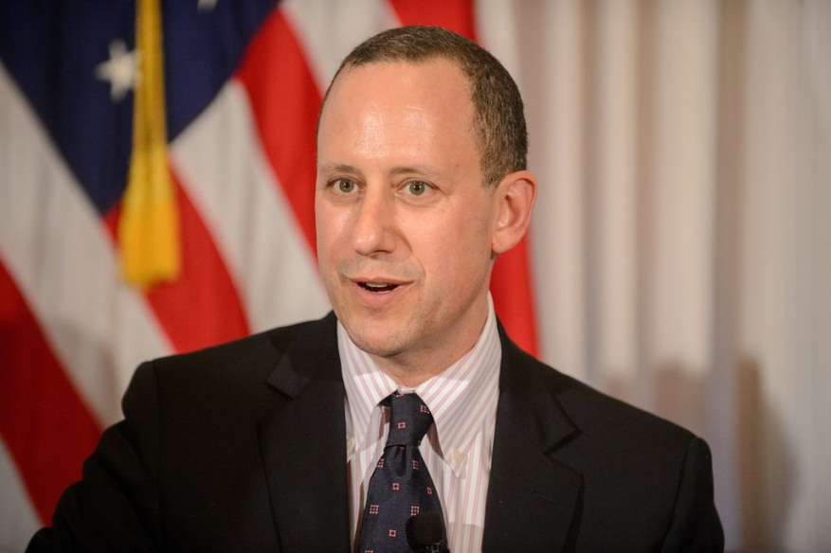
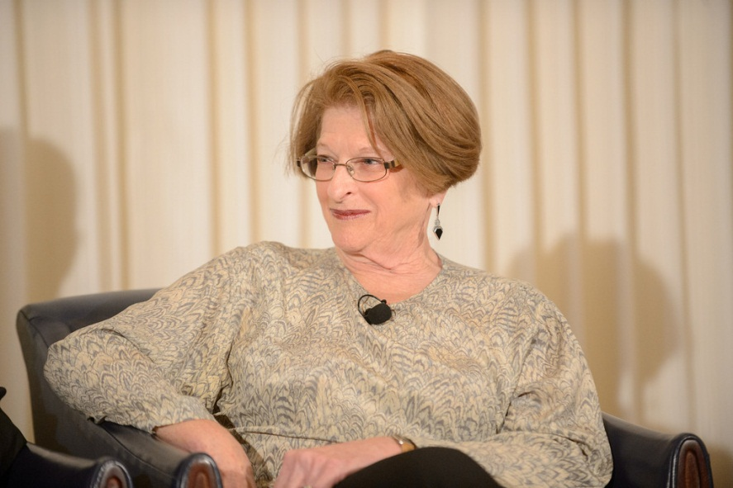
19

Slide 21
What We Will Provide
Monthly webinars
Hypertension Best Practices case studies
Campaign website
Provider toolkit
Anceta data warehouse benchmarking data
Scientific evaluation of the campaign
20

Slide 22
Patients and Consumers
Use tools to monitor blood pressure, manage medications and adopt healthy lifestyle changes
21
Notes:
Ok I would recommend the previous slide to tell what AMGF gives you and then this slide to show what you have to do and then reiterate the benefits at some point. Photo is not good quality unfortunately. Do you have any other real photos or can you take some?
Too busy, too much text
Photos mis-shapen
Break it up
Medical groups will be challenged to adopt one or more evidence-based care processes that lead to
measureable improvements in blood pressure control. To support medical groups in this effort, AMGF will offer a provider toolkit with best practice tips, examples and expert videos; host webinars and other
educational and collaborative opportunities; provide tools to promote involvement with the campaign; access to Anceta (benchmarking and evaluation data); and opportunities for national recognition.

Slide 23
Strategic Partnerships
Government, non-profit and private sector organizations engaged in collaborative partnerships
22
Notes:
Or?

Slide 24
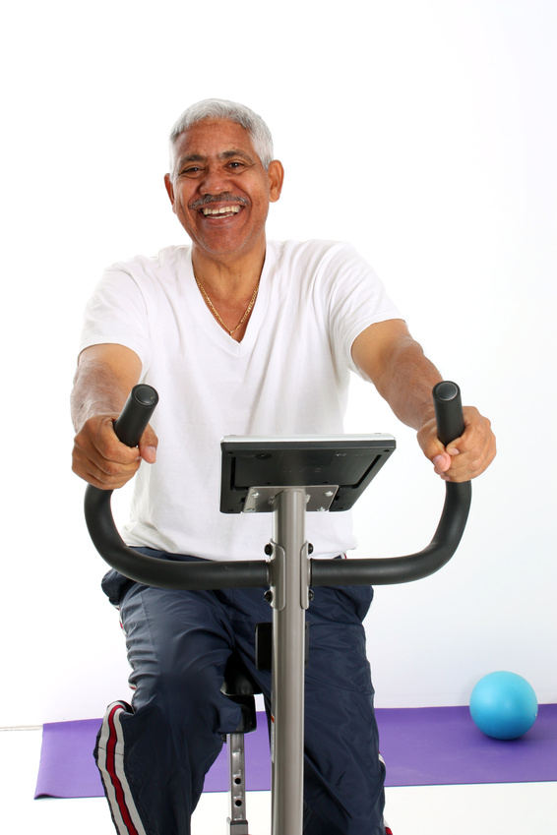
Employers
Employers engage and involve employees in wellness programs and activities with support from the AMGF
23
Notes:
Or?

Slide 25
Media Campaign to Raise Awareness
High profile media events to raise awareness including survey, special events and publishing research findings
24
Notes:
Social media should be part of this not just TV microphones
This is kind of how it could look – can’t get the line out.

Slide 26
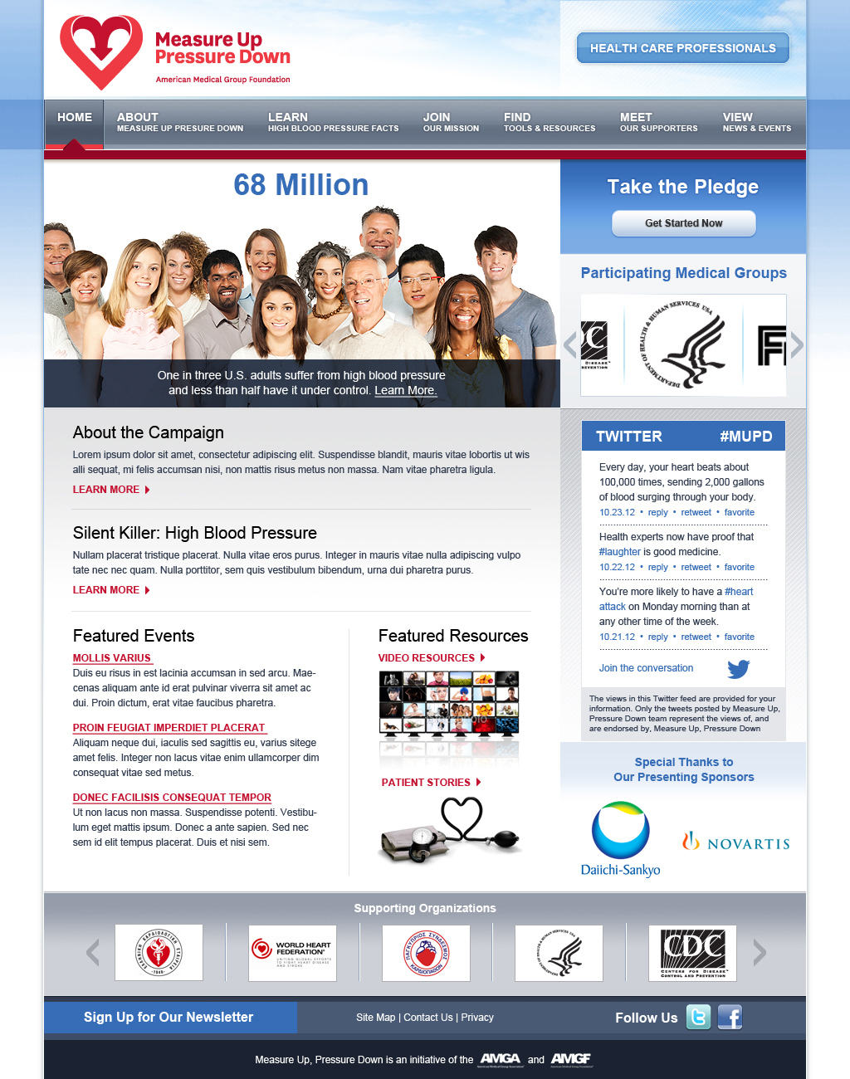
Campaign Website www.MeasureUpPressureDown.com
Health Care Professionals Page
Campaign Brochure
Campaign Registration Link
Frequently Asked Questions (FAQs)
Campaign Intranet/Discussion Board
Best Practices in Hypertension Case Studies
Provider Toolkit
25

Slide 27
Social Media
www.twitter.com/controlpressure
www.facebook.com/measureuppressuredown
www.flickr.com/photos/measureuppressuredown

Slide 28
National Steering Committee
Michael Rakotz, MD
Northshore University Health System Medical Group
Carleton T Rider
AMGF Director and Former Chair
Brooks College of Health University of North Florida
Marie Schall
Director
Institute for Healthcare Improvement
Paul Speigelman
Founder & CEO
BerylHealth
Karol E. Watson, MD
Associate Professor of Medicine and Co-Director, UCLA
Center for Cholesterol and Lipid Management
Lucius F Wright, MD
The Jackson Clinic, P.A.
Kathleen Yaremchuk, MD
VP Clinical Practice Performance
Henry Ford Medical Group
Lawrence Casalino, MD, PhD
Chief, Division of Outcomes and Effectiveness Research
Weill Cornell Physician Organization
Janet Corrigan , PhD, MBA
President and Chief Executive Officer
National Quality Forum
Francis J Crosson, MD
Vice President, Physician Satisfaction:
Care Delivery
American Medical Association
Guy Mansueto
VP of Marketing
Phytel, Inc.
Robert Matthews
Executive Director
PriMed Physicians
Kevin McDermott, MBA
Vice President, Managed Markets
Aptalis Pharma
Michael L Millenson
President
Health Quality Advisors
27

Slide 29
Scientific Advisory Council
Lawrence Casalino, MD, PhD
Chief, Division of Outcomes and Effectiveness Research
Weill Cornell Physician Organization
John Cuddeback, MD, PhD
Chief Medical Information Officer
Anceta
Lawrence J. Fine MD, DrPH
Chief, Clinical Applications and Prevention Branch
Division of Cardiovascular Sciences
National Heart, Lung, and Blood Institute
Harold S Luft, PhD
Director Palo Alto Medical Foundation Research Institute
UC San Francisco School of Medicine
Hector Rodriguez, PhD, MPH
Associate Professor Health Services
UCLA School of Public Health
Sandra Taler, MD
Consultant, Division of Nephrology /Hypertension
Associate Professor of Medicine
Mayo Medical School
Mayo Clinic
Kimberly Westrich, MS
Director, Health Services Research
National Pharmaceutical Council
28

Slide 30
AMGF and
Supporting Organizations
29

Slide 31
Nonprofit 501(c)(3) organization
Identifies innovative best practices in chronic care
Offers grants to selected members to develop their initiatives
Publishes case studies of best practices
Conducts Best Practices in Care Learning Collaboratives
Managing Chronic Obstructive Pulmonary Disease (COPD)
Managing Multiple Chronic Conditions
Accountable Care
Acclaim Award
30
Notes:
What is the AMGA? Why I should care. How I would benefit – maybe work up to that a bit. Show the good works and benefits? Say who else is a member that might be influential – the, “Oh I need to be part of that group if so and so is in it”
Maybe the AMGA’s purpose?
Goal?
Desired Results
Why we exist?
Who we serve?

Slide 32
Presenting Sponsors
Novartis Pharmaceuticals Corporation
Daiichi Sankyo, Inc.
31

Slide 33
Supporting Organizations
32

Slide 34
Outcomes Measurement
33

Slide 35
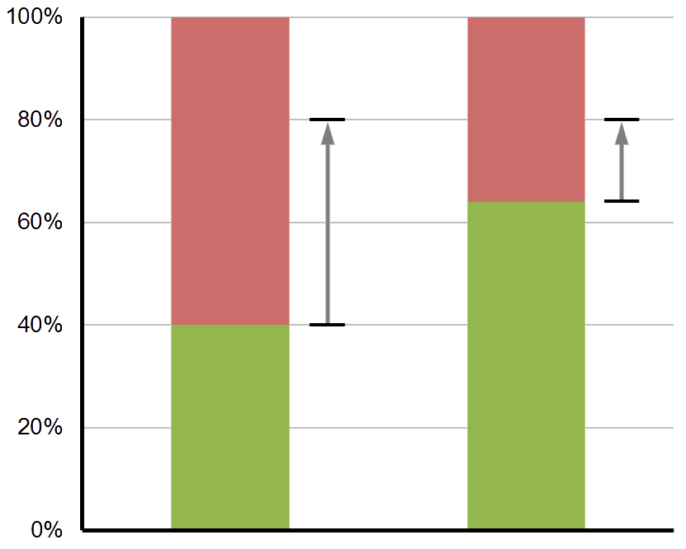
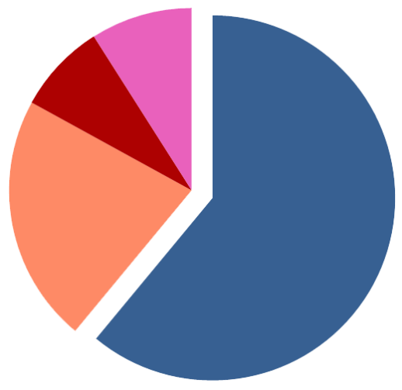
JNC 7 recommendations:
Patients with diabetes or chronic kidney disease, BP < 130/80
All other patients, BP < 140/90
CKD
Diabetes + CKD
Diabetes
Not in control
In control
Uncomplicated
Complicated
Uncomplicated
34

Slide 36
Rigorous measurement and evaluation
Can we move the needle on hypertension detection and control? How much? In which subgroups of patients?
What approaches and interventions are most effective, for different patient populations and clinical settings?
What characteristics of medical groups enable effective intervention?
Partner with an academic or research organization
Basic quantitative evaluation to be funded by campaign sponsors
Seek grant funding for qualitative component—surveys and structured interviews
RFP to be issued shortly
Partner to be selected by Scientific Advisory Council
Measurement plan to be finalized and baseline data collection to begin in first quarter of 2013
35

Slide 37
Proposed Measurement Principles
Correspond to industry-standard measures, adjusted for JNC 7
Adapt to JNC 8 when released
Emphasize delta for each group, rather than group-to-group comparisons
Validated measures, potentially useful in payor negotiations
Some questions to resolve
Which patients? — Of all providers? Of PCPs? Of PCMH practices? Minimum number of visits? Patient attribution (to providers or practices)?
Which BP reading?
How to encourage detection of new patients with hypertension, without penalizing groups in terms of control rates?
How to stratify patient populations or practices for reporting?
Quarterly vs. annual reporting—how to avoid double-counting?
36

Slide 38
AMGF and Anceta will handle reporting and data management
Work directly with “data contact” in each member organization
No additional effort for Anceta participants
Other members, quarterly reporting—numerators and denominators
Measurement Committee
Guidance from participating member organizations
Work with evaluation partner to refine data definitions
Practical reporting and data validation processes
Seeking volunteers: jcuddeback@amga.org
37

Slide 39
Next Steps and
Upcoming Events
38

Slide 40
Next Steps
Complete online assessment survey
Attend upcoming webinars
AMGA will contact your data lead
AMGA will contact your quality lead
Provider Toolkit available by January 2013
Provide Key Marketing Contact
39

Slide 41
Participating Member Organizations
Adirondack Internal Medicine & Pediatrics, P.C. | Billings Clinic | Crystal Run Healthcare
Advocate Medical Group | Brown & Toland Physicians | Dartmouth-Hitchcock Clinic
Advocate Physician Partners | Carolinas Healthcare System | Deaconess Clinic
Alegent Health Clinic | Central Utah Clinic | DuPage Medical Group
Allina Health | Centura Health Physician Group | Essentia Health
Arch Health Partners | Christie Clinic, LLC | Fairview Medical Group
Aurora Health Care | Clackamas County Health Centers | Fletcher Allen Health Care / University of Vermont
Austin Diagnostic Clinic, P.A. | Cleveland Clinic | Geisinger Health System
Austin Regional Clinic, P.A. | Coastal Carolina Health Care PA | Harbin Clinic LLC
Baptist Memorial Medical Group | Colorado Springs Health Partners | Hattiesburg Clinic, P.A.
Baylor Health Care System/Health Provider Network | Community Physician's of Indiana | HealthCare Partners
Bend Memorial Clinic | Compass Medical, P.C. | HealthPartners
Benefis Medical Group | Cornerstone Health Care | HealthPoint Medical Group

Slide 42
Participating Member Organizations
Henry Ford Medical Group | Mayo Clinic Health System | NEA Baptist Clinic
Heritage Valley Medical Group | Medical Associates Clinic, P.C. | New West Physicians
INOVA | Medical Associates, PLC | North Mississippi Medical Clinics, Inc.
Intermountain Healthcare | Medical Clinic of North Texas P. A | North Texas Specialty Physicians
Iowa Clinic | Medstar | NorthShore University HealthSystem Medical Group
Kelsey-Seybold Clinic | Mercy Clinic Northwest Arkansas | Northwest Primary Care Group PC
Lahey Clinic | Mercy Des Moines | Norton Physicians Services
Lakeshore Clinic | Mercy Ministry | Novant Medical Group
Lakeshore Health Partners | Meritage Medical Network (Marin-Sonoma IPA) | Oregon Medical Group, P.C.
Latham Medical Group | Mid-Atlantic Permanente Medical Group | OU Physicians
Maitland Family Practice | MIMA | Pacific Medical Centers
Mankato Clinic | Mount Kisco Medical Group | Park Nicollet Health Services

Slide 43
Participating Member Organizations
Parkview Physicians' Group | Rockwood Clinic | Susquehanna Health Medical Group
PeaceHealth | Sacramento Family Medical Centers | Sutter Independent Physicians
Piedmont Healthcare | Scripps Coastal Medical Group | Sutter Medical Group
Portland IPA | Scripps Medical Foundation | Sutter North Medical Group
Prevea Health Services | Sentara Medical Group | Swedish American Medical Group
PriMed Physicians | Shannon Medical Center | The Everett Clinic
ProHealth Physicians | Sharp Rees-Stealy Medical Group | The Jackson Clinic, P.A.
Puget Sound Family Physicians | Shaw Center for Women's Health | The Permanente Medical Group
Refuah Health Center | Springfield Clinic | ThedaCare Physicians
Reliant Medical Group | St Anthony's Physician Services | Triad HealthCare Network
Riverside Medical Clinic | St. Luke's Physician Group | TriHealth Practices
Riverside Medical Group | State of Franklin Healthcare Associates, PLLC | University of Utah Community Clinics
Rockford Health Physicians | Summit Medical Group | Upper Valley Family Care
42

Slide 44
Participating Member Organizations
Weill Cornell Physician Organization
Wellmont Medical Associates
Wenatchee Valley Medical Center
Western Montana Clinic
Westmed Medical Group
Wheaton Franciscan Medical Group
Wilmington Health
43

Slide 45
Webinar Schedule 2:00pm – 3:00pm EDT Monthly
Date | Topic | Plank | Speaker
Jan 17, 2013 | Getting started with QI |  | Institute for Healthcare Improvement
Feb 21, 2013 | Direct Care Staff trained in accurate BP measurement | 1 | Cleveland Clinic
Mar 21, 2013 | Hypertension Guideline used and adherence monitored | 2 | Kaiser Permanente – Mid-Atlantic
Apr 18, 2013 | BP addressed for every hypertension patient, every primary care visit | 3 | PriMed Physicians
May 16, 2013 | All patients not at goal and with new Rx seen within 30 days | 4 | Sharp Rees-Stealy Medical Group
Jun 20, 2013 | Prevention, engagement, and self -management program in place | 5 | Mercy Clinics Iowa
Jul 18, 2013 | Registry used to identify and track hypertension patients | 6 | Anceta
Aug 15, 2013 | All specialties intervene with patients not in control | 8 | Park Nicollet Health Services
Sep 19, 2013 | All team members trained in importance of BP goals | 7 | Billings Clinic
Oct 17, 2013 | Physician Engagement |  | Columbia St Mary’s Physicians
Nov 21, 2013 | Health Equity |  | Association of Black Cardiologists
Dec 19, 2013 | Pharmacist role |  | Marshfield
44

Slide 46
Thank You for participating in Measure Up Pressure Down
Questions?
45

